Slide 1
Curriculum, Instruction, and Assessment Progress Summary
October 21, 2014

Slide 2
Verona Public
Schools Mission Statement
“The mission of the Verona Public Schools, the center of an engaged and supportive community, is to empower students to achieve their potential as active learners and productive citizens through rigorous curricula and meaningful, enriching experiences.”

Slide 3
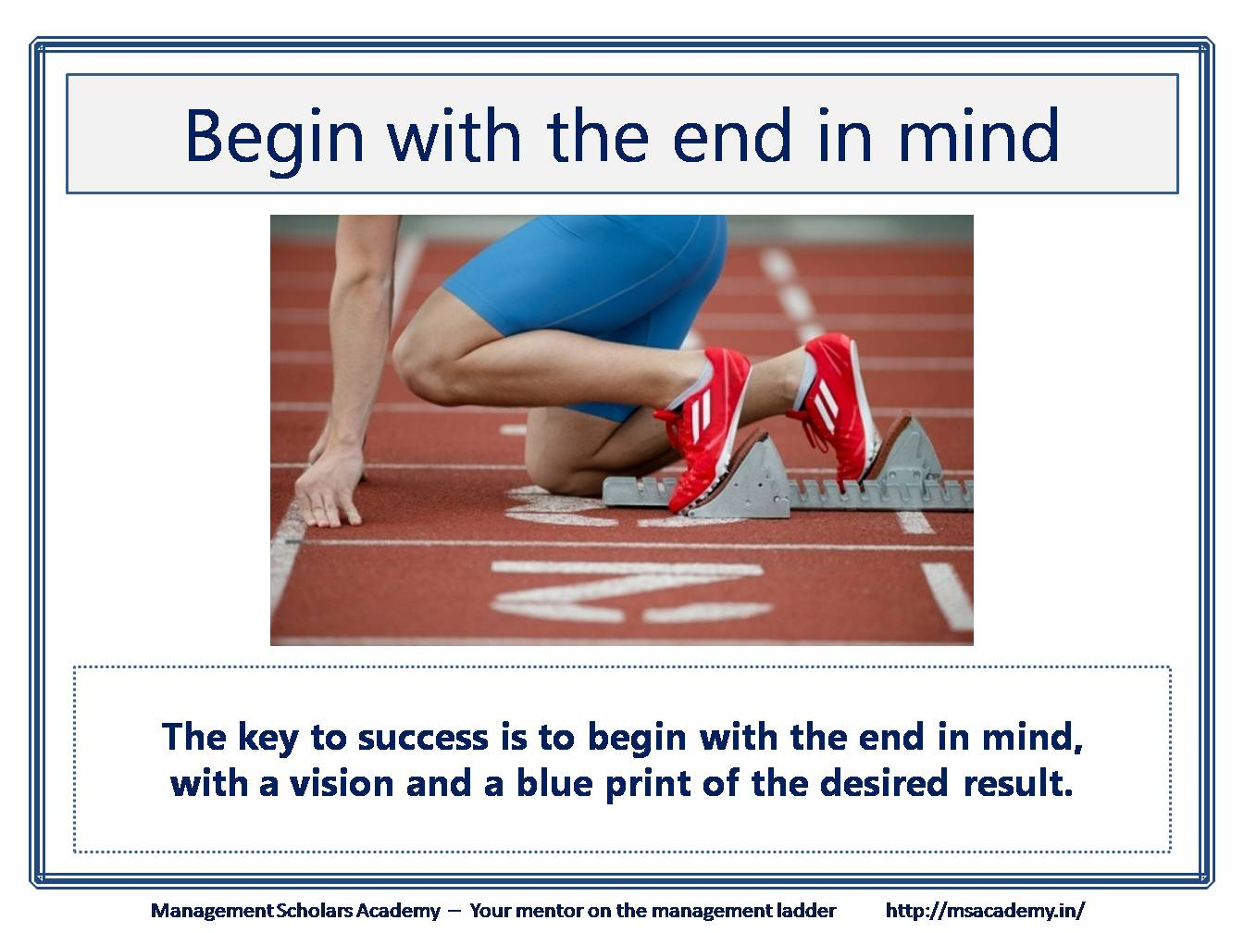
District Goal: Facilitate the creation or revision of assessments and performance tasks that will be common to the department and that will reflect levels of complexity and depth of knowledge.

Slide 4
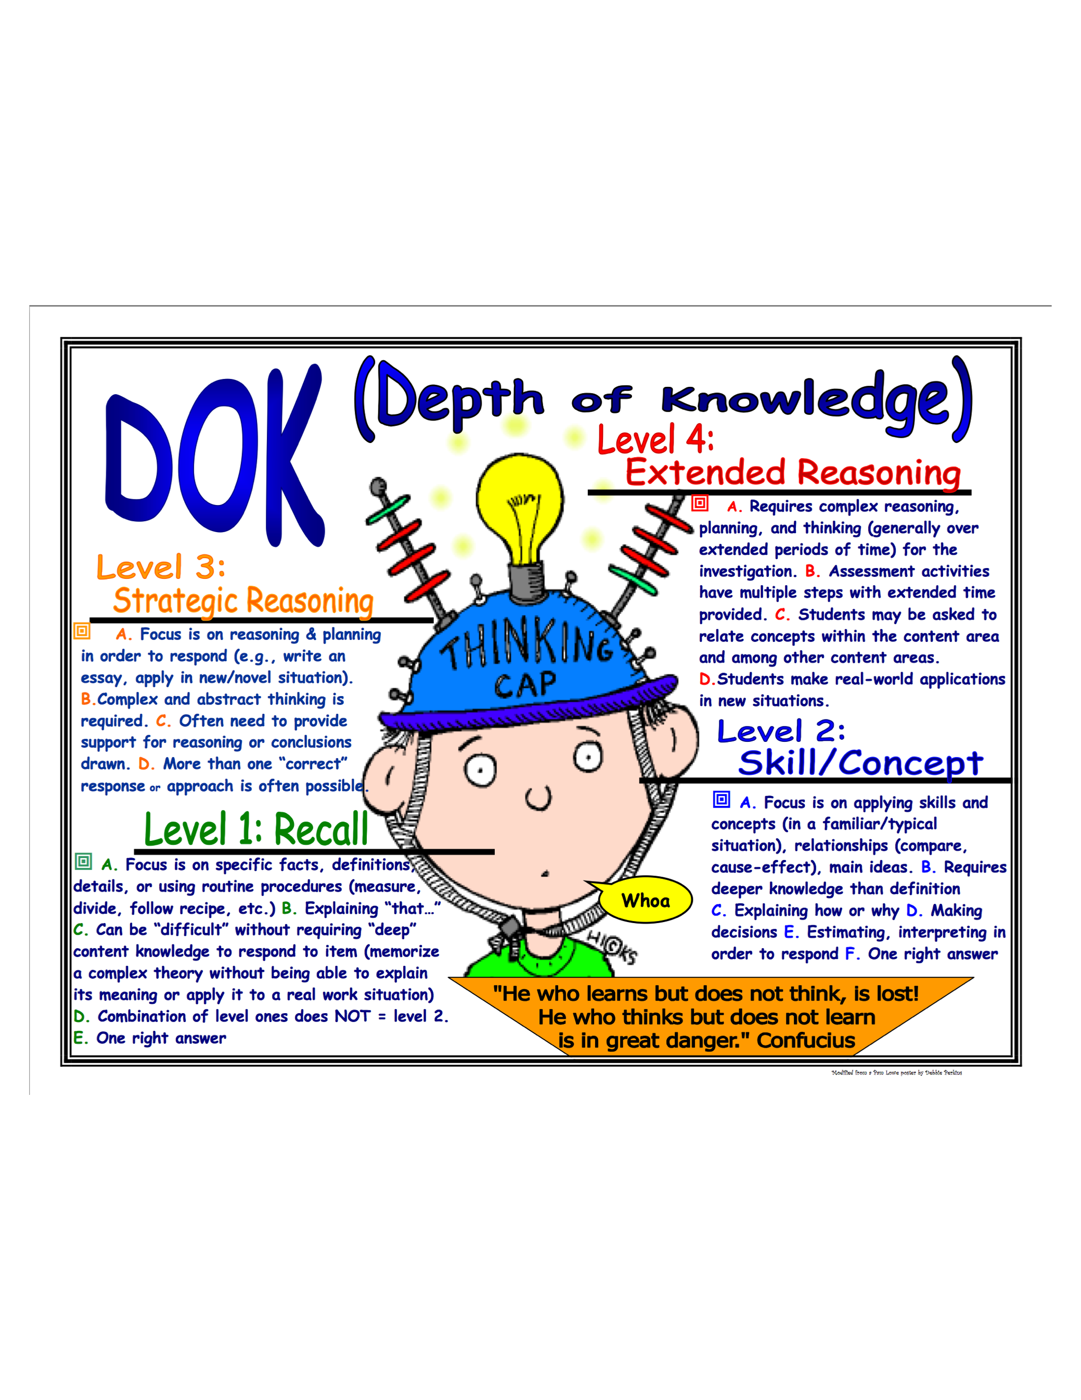
District Goal = Complex Assessments
Focus on enriching question complexity to approach PARCC
  1/3 DOK 1 : 1/3 DOK 2 : 1/3 DOK 3 to mimic EOY (May PARCC Tests)
  Transfer Tasks should approach DOK 4 to mimic PBA (March PARCC Tests)

Slide 5
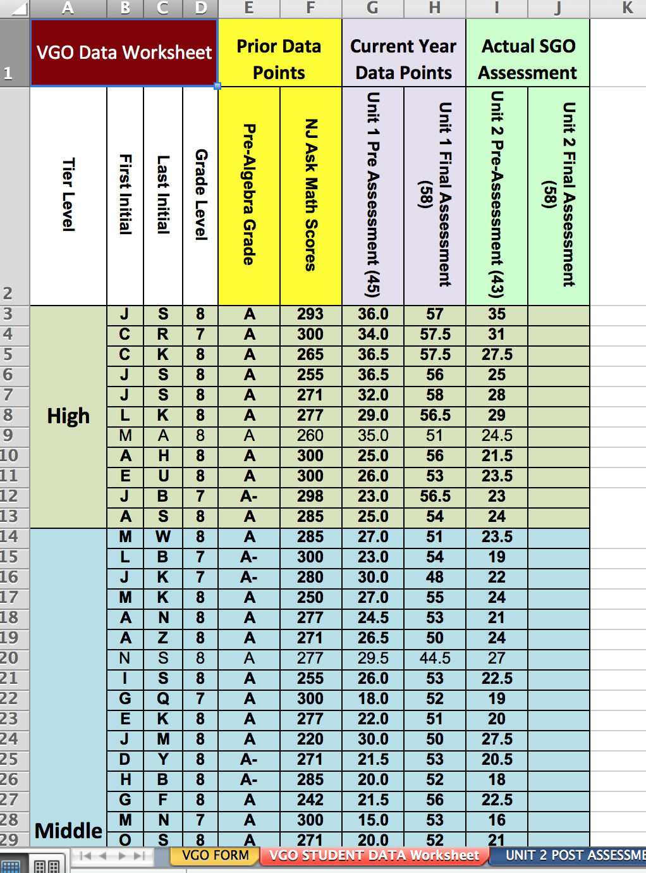
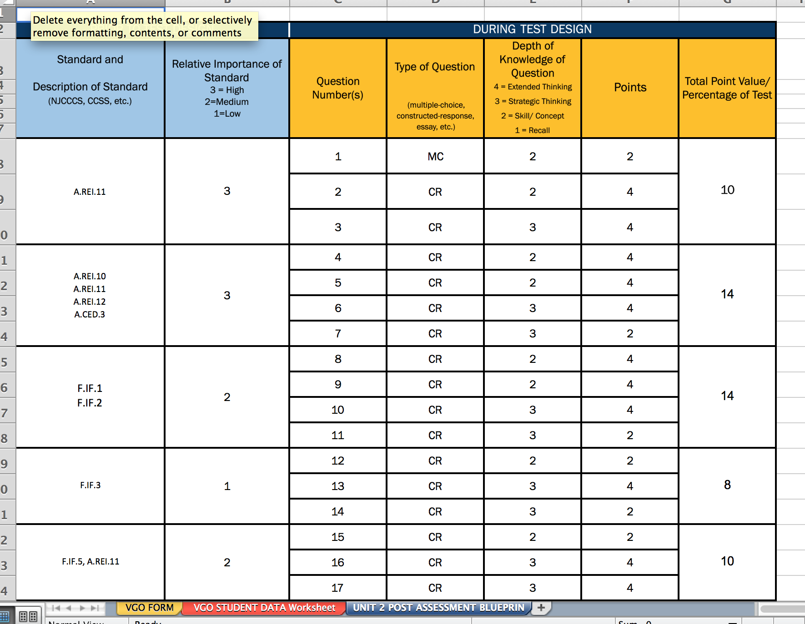
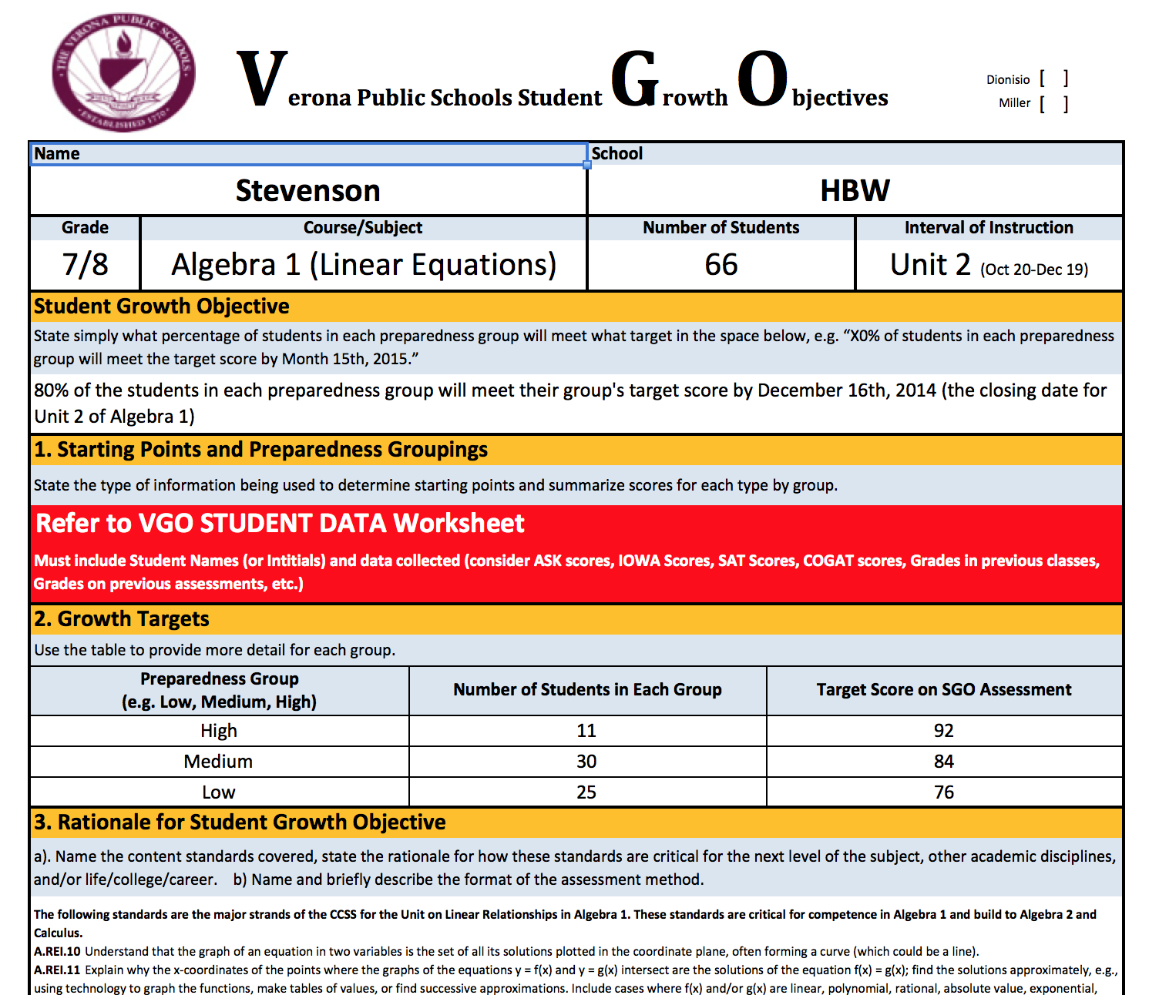
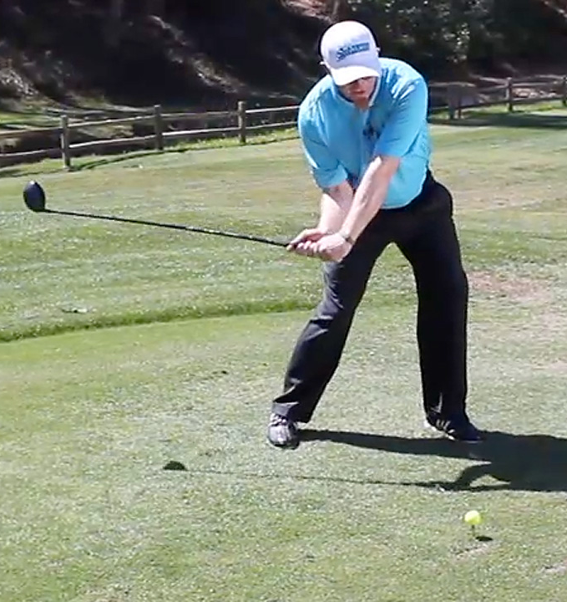

Verona Student Growth Objectives (VGOs)
Streamlined Excel Form http://www.veronaschools.org/Page/4343
Data form included
Designed & vetted using Assessment Blueprint Spreadsheet
    Teacher Driven!
VGO

Slide 6
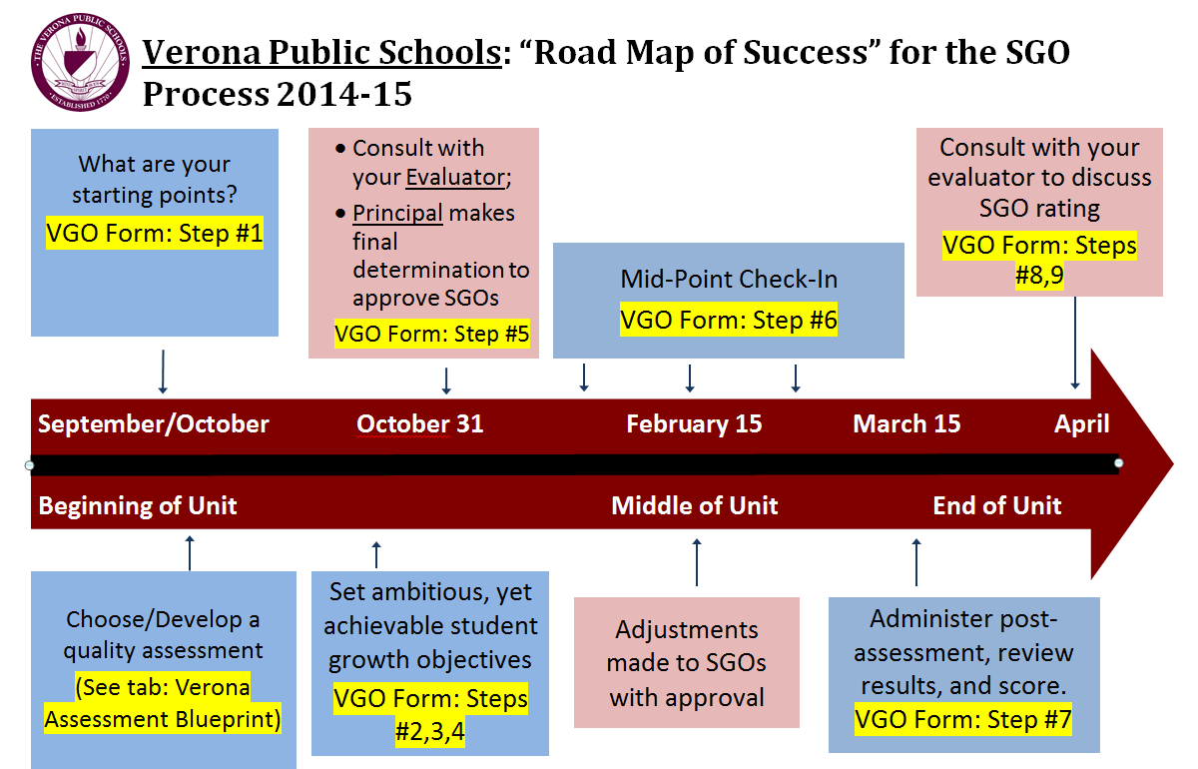
VGO Road Map of Success

Slide 7
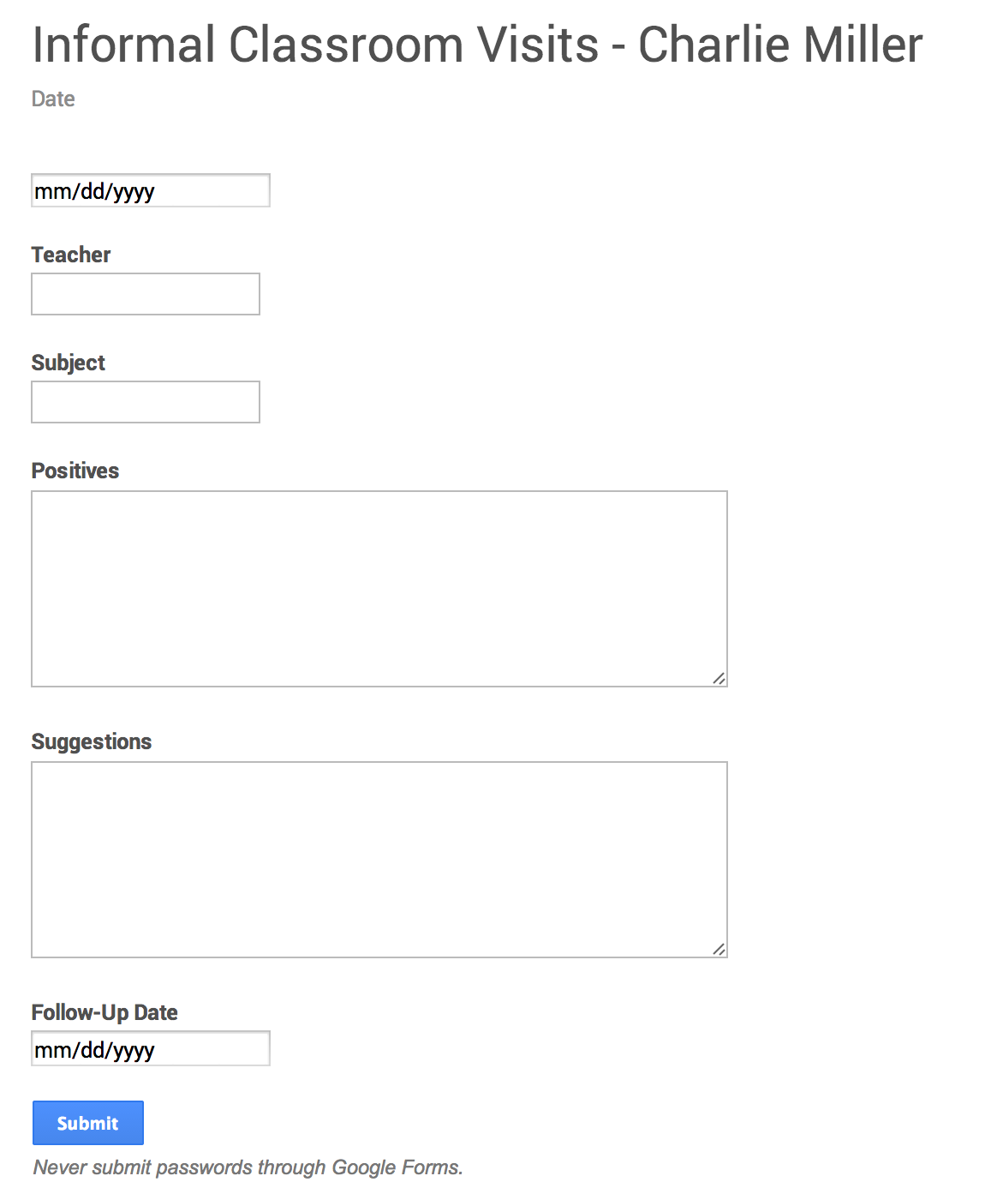
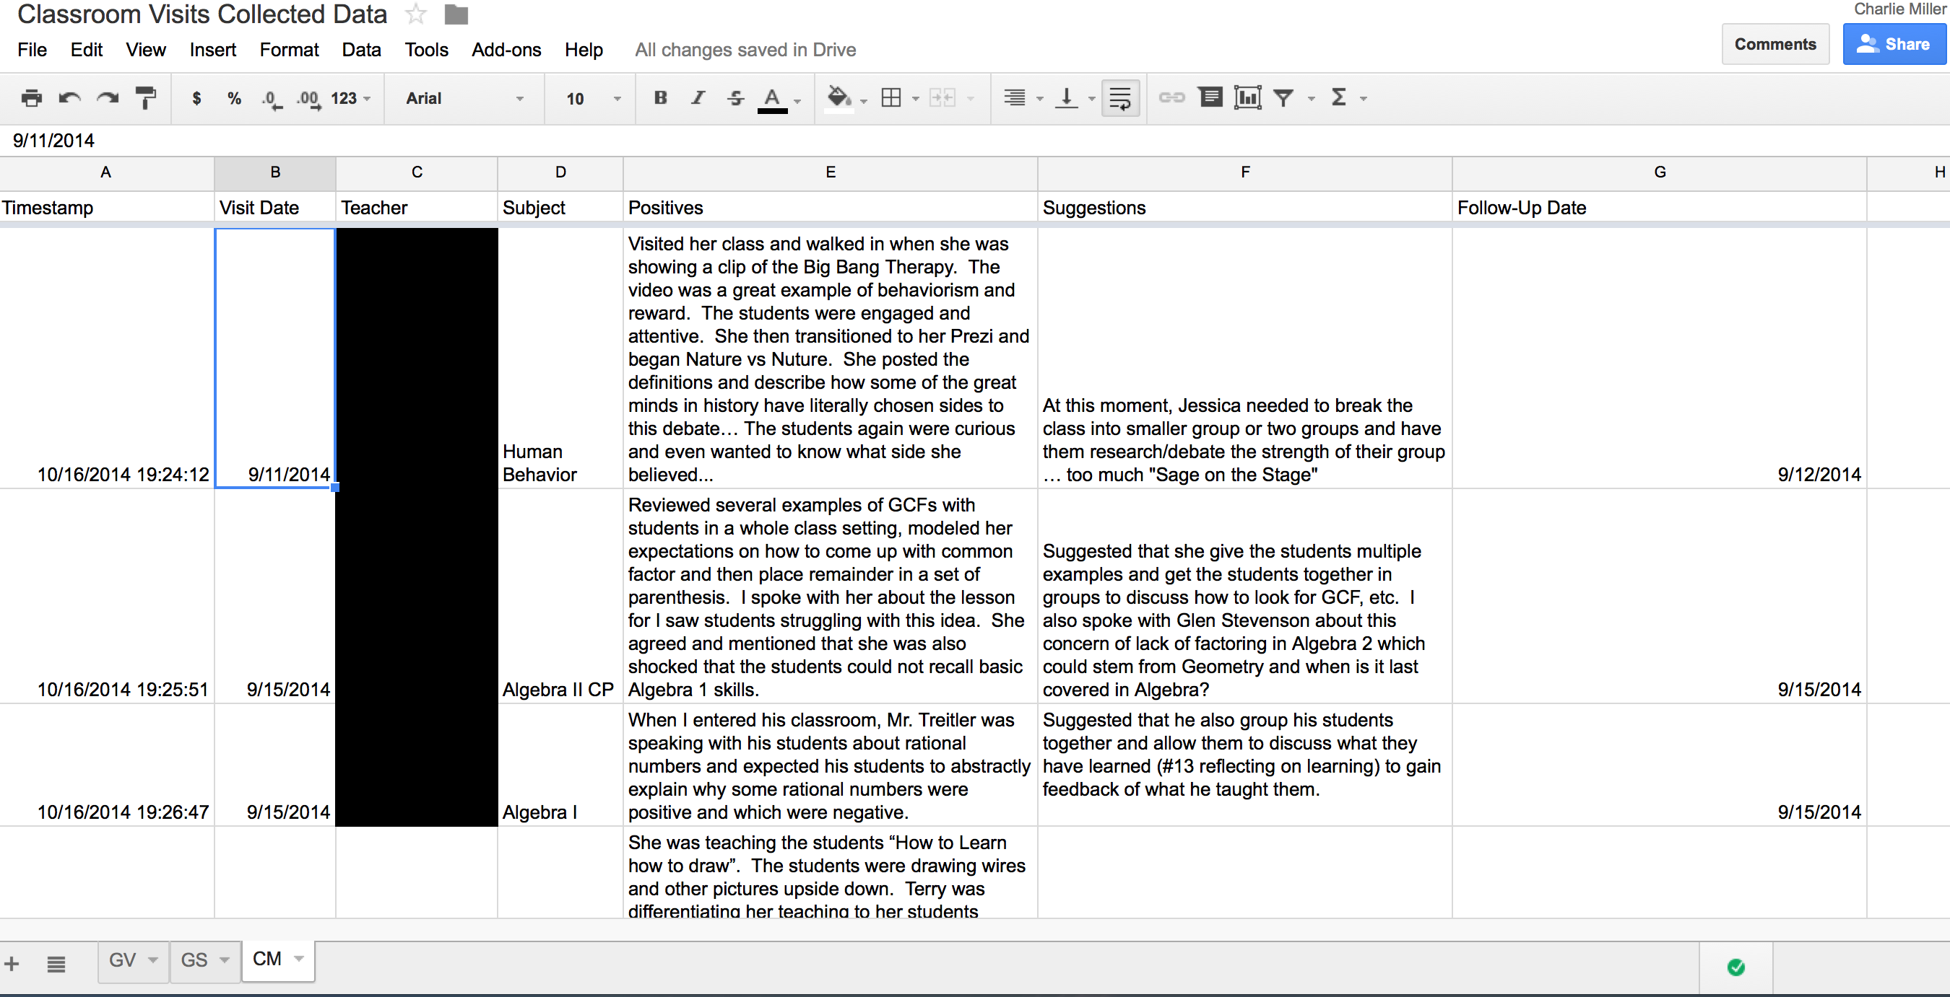
2014-15 Teacher Evaluation Updates
In 2012-13, we observed tenured teachers 1 time and non-tenured teachers 3 times for a total of 300 observations.
In 2013-14, we observed tenured teachers 3 times and non-tenured teachers 3 times for a total of 550 observations.
For 2014-15, our waiver was approved by Essex County and NJDOE to observe tenured teachers 2 times and non-tenured teachers 3 times for a total of 450 observations.
  Additionally, we will informally visit each teacher’s classroom on a monthly basis to provide instant feedback. We will gain another 1600 informals totaling over 2000 observations!
Notes:
Waiver Approved (Tenure = 2, Non-Tenured = 3)
Monthly Informal Classroom Visits
10-15 minute & 5 minute follow-up
Evidence of planning available during visit
Reflect on Domains 2, 3, & 4 Monthly

Slide 8
Elementary ELA (Grades 3&4)
Curricular Focus: Reading & Writing Workshop
%PP is lower than DFG I Peers in Grades 3&4 last two years!
Reading and Writing Clusters Mean Scores Competitive With DFG I
  Green highlight = surpassed DFG I Mean
  Blue = gap remains narrow between Verona and DFG I Mean
ASK 3 ELA | 12-13 |  | 13-14
Common Core Standards | V Mean | DFG I Mean | V Mean | DFG I Mean
Writing | 10.9 | 11 | 11.1 | 11.1
Inform/Expl |  |  | 5.3 | 5.4
Narrative |  |  | 5.8 | 5.7
Reading | 19.1 | 18.8 | 17.7 | 18.2
Literature |  |  | 5.8 | 6
Inform. Text |  |  | 11.9 | 12.2
%PP | 15.8% | 17.2% | 14.4% | 17.2%
ASK 4 ELA | 12-13 |  | 13-14
Common Core Standards | V Mean | DFG I Mean | V Mean | DFG I Mean
Writing | 12.4 | 12.6 | 11.3 | 11.5
Inform/Expl |  |  | 5 | 5.1
Narrative |  |  | 6.3 | 6.4
Reading | 23.7 | 23.1 | 20.8 | 20.9
Literature |  |  | 7.2 | 7.1
Inform. Text |  |  | 13.6 | 13.8
%PP | 20.0% | 21.4% | 19.6% | 20.1%
Notes:
The Yellow highlights are our defined areas of focus. The Blue highlight marks our progress or narrower of the gap. Green highlighting is where we are exceeding the DFG I.
Note: Each cluster can be worth different number of points one year to the next.

Slide 9
HBW ELA (Grades 5-8)
%PP is lower than DFG I Peers in Grades 5, 6, & 8
Reading & Writing Clusters Now Exceed the DFG I Mean in Grades 5, 6 & 8 (see 13-14 Green Highlights)
ASK 5 ELA | 12-13 |  | 13-14 |  |  | ASK 6 ELA | 12-13 |  | 13-14
Common Core Standards | V Mean | DFG I Mean | V Mean | DFG I Mean |  | Common Core Standards | V Mean | DFG I Mean | V Mean | DFG I Mean
Writing | 12.8 | 13.2 | 12.3 | 12.1 |  | Writing | 11.1 | 11.2 | 11.9 | 11.5
Inform/Expl |  |  | 6 | 5.9 |  | Inform/Expl |  |  | 7.9 | 7.6
Narrative |  |  | 6.4 | 6.2 |  | Narrative |  |  | 4 | 3.9
Reading | 25.2 | 25.6 | 25.7 | 25.6 |  | Reading | 33.6 | 34 | 35.1 | 33.6
Literature |  |  | 9.2 | 9 |  | Literature |  |  | 18 | 17.3
Inform. Text |  |  | 16.5 | 16.6 |  | Inform. Text |  |  | 17.1 | 16.4
%PP | 20.8% | 20.4% | 14.4% | 18.0% |  | %PP | 19.4% | 16.0% | 9.4% | 14.9%
ASK 7 ELA | 12-13 |  | 13-14 |  |  | ASK 8 ELA | 12-13 |  | 13-14
Common Core Standards | V Mean | DFG I Mean | V Mean | DFG I Mean |  | Common Core Standards | V Mean | DFG I Mean | V Mean | DFG I Mean
Writing | 12.3 | 11.8 | 11.3 | 11.5 |  | Writing | 12.3 | 12.1 | 13 | 12.1
Inform/Expl |  |  | 7.4 | 7.5 |  | Inform/Expl |  |  | 8.8 | 8.1
Narrative |  |  | 3.9 | 4 |  | Narrative |  |  | 4.2 | 4
Reading | 33.5 | 33.3 | 32.5 | 33.9 |  | Reading | 37.9 | 37.3 | 37.8 | 37.4
Literature |  |  | 9 | 9.2 |  | Literature |  |  | 19.1 | 18.8
Inform. Text |  |  | 23.5 | 24.7 |  | Inform. Text |  |  | 18.8 | 18.7
%PP | 9.9% | 15.4% | 19.6% | 16.3% |  | %PP | 6.4% | 6.5% | 5.3% | 7.0%

Slide 10
Elementary Math (Grades 3&4)
Year 2 Assessing Common Core State Standards in Math
%PP gap continues to narrow in Grade 4!
Cluster on Measurement & Data has decreased in Grade 4!
Cluster Focus on Fractions continues for 2014-15
  Compacted & Revised the Curriculum in Grades 3 & 4
  Updated textbooks and supplementary materials
  Using examples from the State Model Curriculum Unit Tests
  Emphasizing “key” grade level standards
  Elementary teachers and Administrators focused on DOK Unit Tests
ASK 3 MATH | 12-13 |  | 13-14 |  |  | ASK 4 MATH | 12-13 |  | 13-14
New Common Core Clusters | V Mean | DFG I Mean | V Mean | DFG I Mean |  | New Common Core Clusters | V Mean | DFG I Mean | V Mean | DFG I Mean
Operations & Algebraic Thinking | 8.7 | 9.1 | 9.6 | 10.5 |  | Operations & Algebraic Thinking | 6.6 | 7.2 | 5.4 | 6.2
Number & Operations in Base Ten | 4.7 | 4.6 | 4.4 | 4.8 |  | Number & Operations in Base Ten | 7.3 | 7.9 | 6.9 | 7.4
Number & Operations - Fractions | 5.8 | 7.0 | 6.0 | 7.4 |  | Number & Operations - Fractions | 12.6 | 13.7 | 12.3 | 13.3
Measurement & Data | 10.1 | 10.4 | 9.2 | 9.8 |  | Measurement & Data | 2.3 | 2.8 | 3.9 | 4.2
Geometry | 5.1 | 5.1 | 4.8 | 5.1 |  | Geometry | 4.8 | 4.6 | 4.5 | 4.5
%PP | 9.5% | 9.3% | 12.3% | 10.7% |  | %PP | 13.7% | 9.0% | 14.6% | 11.1%
Notes:
These charts compare our district results from 2013 (most recently available data statewide) vs. our baseline year of 2008.
You can see the math clusters – the scores are the mean for each cluster in Verona alongside the DFG mean.
The Yellow highlights are our defined areas of focus. The Blue highlight marks our progress or narrower of the gap. Green highlighting is where we are exceeding the DFG I.
Note: Each cluster can be worth different number of points one year to the next.

Slide 11
HBW Math (Grades 5-8)
Year 1 Assessing Common Core State Standards in Math 6-8
%PP is lower than DFG I Peers in Gr. 8 & narrowed in Gr. 5-7
Cluster Focus Highlighted in Yellow:
  Fractions in Grade 5
  Ratio & Proportional Relationships in Grade 7
  Statistics & Probability in Grades 6 & 8
ASK 5 MATH | 13-14 |  |  | ASK 6 MATH | 13-14
Common Core Clusters | V Mean | DFG I Mean |  | Common Core Clusters | V Mean | DFG I Mean
Operations & Algebraic Thinking | 4.3 | 4.6 |  | Ratio & Proportional Relationships | 5.2 | 5.6
Number & Operations in Base Ten | 8.4 | 8.7 |  | The Number System | 9.8 | 9.8
Number & Operations - Fractions | 9.2 | 10.1 |  | Expressions & Equations | 10.9 | 10.9
Measurement & Data | 9.6 | 9.8 |  | Geometry | 4.4 | 4.7
Geometry | 4.8 | 4.8 |  | Stats. & Prob. | 4.0 | 4.7
%PP | 8.4% | 8.3% |  | %PP | 8.4% | 8.3%
ASK 7 MATH | 13-14 |  |  | ASK 8 MATH | 13-14
Common Core Clusters | V Mean | DFG I Mean |  | Common Core Clusters | V Mean | DFG I Mean
Ratio & Proportional Relationships | 3.6 | 4.3 |  | The Number System | 4.7 | 4.5
The Number System | 7.9 | 8.3 |  | Expressions & Equations | 9.7 | 10.0
Expressions & Equations | 10.3 | 10.6 |  | Functions | 7.3 | 7.2
Geometry | 4.3 | 5.0 |  | Geometry | 8.5 | 8.5
Stats. & Prob. | 4.4 | 4.6 |  | Stats. & Prob. | 4.2 | 4.4
%PP | 17.2% | 16.1% |  | %PP | 11.1% | 13.1%
Notes:
The Yellow highlights are our defined areas of focus. The Blue highlight marks our progress or narrower of the gap. Green highlighting is where we are exceeding the DFG I.
Note: Each cluster can be worth different number of points one year to the next.

Slide 12
VHS – HSPA (11th Grade)
Overall: %PP scores have decreased each year & %PP score “gap” has narrowed between Verona and our DFG I Peers
Overall: %AP scores have increased each year & %AP score “gap” has narrowed between Verona and our DFG I Peers
Since 2008, we have increased Advanced Placement participation & performance, focused on Dual-Enrollment classes to earn college credit, and created New Elective courses
HSPA Language Arts Literacy Partial Proficient (%PP) Results
 | Verona PP | DFG I PP | Difference
2008 | 8.00% | 6.20% | 1.80%
2009 | 9.60% | 5.60% | 4.00%
2010 | 4.70% | 3.80% | 0.90%
2011 | 4.60% | 3.50% | 1.10%
2012 | 1.40% | 2.70% | -1.30%
2013 | 1.90% | 2.60% | -0.70%
2014 | 1.20% | 1.90% | -0.70%
HSPA Mathematics Partial Proficient Results
 | Verona PP | DFG I PP | Difference
2008 | 13.90% | 10.00% | 3.90%
2009 | 18.40% | 11.50% | 6.90%
2010 | 23.30% | 10.80% | 12.50%
2011 | 16.30% | 11.10% | 5.20%
2012 | 11.60% | 8.90% | 2.70%
2013 | 8.40% | 8.60% | -0.20%
2014 | 10.50% | 8.20% | 2.30%
HSPA Language Arts Literacy Advanced Proficient (%AP) Results
 | Verona AP | DFG I AP | Difference
2008 | 11.70% | 22.80% | -11.10%
2009 | 19.90% | 25.90% | -6.00%
2010 | 14.70% | 34.30% | -19.60%
2011 | 23.50% | 43.40% | -19.90%
2012 | 29.30% | 38.00% | -8.70%
2013 | 38.70% | 45.40% | -6.70%
2014 | 43.20% | 55.10% | -11.90%
HSPA Mathematics Advanced Proficient Results
 | Verona AP | DFG I AP | Difference
2008 | 30.70% | 42.50% | -11.80%
2009 | 27.90% | 41.20% | -13.30%
2010 | 26.70% | 42.70% | -16.00%
2011 | 27.50% | 43.40% | -15.90%
2012 | 30.60% | 46.70% | -16.10%
2013 | 39.60% | 48.50% | -8.90%
2014 | 40.10% | 50.00% | -9.90%

Slide 13
VHS – Advanced Placement
Advanced Placement participation has been encouraged and was targeted for improvement beginning in 2008.
To achieve that, we have:
  Made it easier for students to enroll
  Changed the content and teaching assignments, updated curriculum, and conducted staff trainings
  Maintained/Increased % 3’s or better while doubling our student participation!
 | 2008 | 2009 | 2010 | 2011 | 2012 | 2013 | 2014 | 2015
% 3’s or better | 49% | 59% | 71% | 64% | 72% | 64% | 69% | ??
# tests administered | 225 | 145 | 170 | 183 | 271 | 368 | 402 | 397
Total # AP Students | 108 | 82 | 75 | 89 | 127 | 171 | 174 | 191

Slide 14
VHS AP Scholars since 2009
12 AP Scholars in 2009; 65 AP Scholars in 2014!
Notes:
VHS students have been earning more AP Scholar recognition since 2009 and we have found:
The more we encourage our students to participate in AP classes, the more AP Scholars …

Slide 15
AP Highlights of Spring 2014
Average of 3.61 over the last six years!

Slide 16
AP Highlights of Spring 2014
Enrollment = 37% of the Senior Class!

Slide 17
AP Highlights of Spring 2014
1st in the state of NJ for Participation!

Slide 18
PARCC (Partnership for Assessment of Readiness for College and Careers)
What states make up PARCC?
  Arkansas, Colorado, District of Columbia, Illinois, Maryland, Massachusetts, Mississippi, New Jersey, New Mexico, New York, Ohio, and Rhode Island.
What are the components of the PARCC assessment system?
  Performance-based assessments (PBA) in ELA/literacy and mathematics. All students will take this summative test in March.
  End-of-year assessments (EOY) in ELA/literacy and math in May.
  The results will be combined with the performance-based assessment to produce a student’s summative assessment score (results will be release late September).
Notes:
Performance-based assessments (PBA) in ELA/literacy and mathematics. All students will take this summative test in March.
In ELA/literacy, this will involve analyzing literature and a narrative writing task.
Students will read texts and write several pieces to demonstrate they can read and understand sufficiently complex texts independently;
Write effectively when using and analyzing sources; and
Build and communicate knowledge by integrating, comparing and synthesizing ideas.
In math, students will be asked to:
Solve problems involving the key knowledge and skills for their grade level (as identified by the CCSS),
Express mathematical reasoning and construct a mathematical argument, and
Apply concepts to solve model real-world problems.
End-of-year assessments (EOY) in ELA/literacy and math.
All students will take this in May. The results will be combined with the performance-based assessment to produce a student’s summative assessment score.
For the end-of-year assessment, students will demonstrate their acquired skills and knowledge by answering computer-based, machine-scorable questions.

Slide 19
PARCC (Partnership for Assessment of Readiness for College and Careers)
How are we preparing for PARCC?
  Curriculum = Common Core State Standards
  District Goal = Complex Assessments
  Elementary: Students visit computer labs at least once per week for Reading/Writing Workshop, Math Instruction, etc.
  HBW: Students visit computer lab to gain familiarity with PARCC Practice Questions, Equation Editor, Highlighting of Passages, etc.*
  VHS: Students will rotate during lunch to gain familiarity with PARCC Practice Questions, Equation Editor, Highlighting of Passages, etc.*

Slide 20
Google Chromebook Initiative
21st Century Learning
  Curriculum, Instruction, and Assessment
215 for HBW
    7 Carts of 30 (plus 5)
185 for VHS
    6 Carts of 30 (plus 5)
Wi-Fi to be installed by January 2015
Strategically position the carts in each building
Train teachers at Google University this spring and summer!

Slide 21
Humanities (Summer Curriculum)
Elementary | ELA (Grade 3) ELA (Grade 4)
Middle | Grade Six Social Studies
High | SUPA Non-Fiction English II CP Broadcast Journalism AP US History Modern World History CP/Honors Criminal Justice SUPA Human Behavior Global Perspectives Spanish III

Slide 22
Humanities (Elementary)
Literacy across the disciplines
  Development of interdisciplinary units
  Social Studies & Science
Differentiation: Small group instruction during workshop
  Guided reading & strategy groups
  Partnerships
  Book clubs

Slide 23

Family Literacy Night

Slide 24
Humanities (HBW)
Adoption of New ELA series
  Grades Five, Six, Seven
  Online student accounts help to engage students in PARCC preparation
Promotion of informational based reading across the disciplines
  Continued work with Periodicals
  Connecting with fiction/literature
  Primary source analysis
  Document Based Questions (DBQs)

Slide 25
Humanities (VHS)
Promotion of informational based reading across the disciplines
  Connecting with fiction/literature
  Primary source analysis
  Document based questions (DBQs)
Expansion of dual enrollment courses
  Nonfiction
  Human Behavior

Slide 26
Humanities (World Language)
Development of Common assessments foster growth on promoting the four domains of the target language
  With focus upon: Speaking & Listening

Slide 27
Special Education
Summer Curriculum Writing
  Preschool Revision
  Consumer Math (Revision of Levels I and II)
  Job Sampling/Transition

Slide 28
Preschool
The NJ Preschool Teaching Standards now match the Common Core Standards for kindergarten
More clarity as to what students should know by the end of the 4 yr old year in preschool
End of unit assessments are being created for ALL the new math and LAL units

Slide 29
Consumer Math (VHS)
Curriculum is framed around many of the 21st Century Life and Careers Standards
Provides alternative options for students in math
Level I teaches students many isolated skills
Level II teaches students to develop realistic financial goals and to develop and maintain a budget.

Slide 30
Job Sampling/Transition (VHS)
Two courses are more of a program than a curriculum
Program for students who are exploring post-secondary options
Curriculum is framed around many of the 21st Century Life and Careers Standards

Slide 31
STEM (Summer Curriculum)
Elementary | Math (Grade 3) Math (Grade 4) Engineering by Design (EbD - Grades 3 & 4)
Middle | Intro to Computers (Comp. Sci. Grade 5) Intro to Computer Programing (Comp. Sci. Grade 6)
High | Algebra II CP/Honors AP Environmental Science (APES)

Slide 32
STEM(Elementary)
Math
  Unit Focus: Aligning to the CCSS
  Compaction: 4 or 5 units
EbD
  Year 1: Water
  Year 2: Renewable Energy

Slide 33
STEM (HBW)
Comp. Sci. Cycles for 5th and 6th Grades
  Intro to Computers
  Intro to Computer Programing
Promotion of Coding and STEM focus

Slide 34
STEM (VHS)
Algebra 2
  Alignment to PARCC
AP Environmental Science (APES)
  UbD Approach combined with the College Board Guidelines

Slide 35
STEM (District)
Next Generation Science Standards
  Adopted by the State Board in August
  Implementation Timeline:
    Grades 6-12: 2016-17
    Grades K-5: 2017-18
  Science Curriculum to be rewritten to include aspects of Engineering and Design

Slide 36
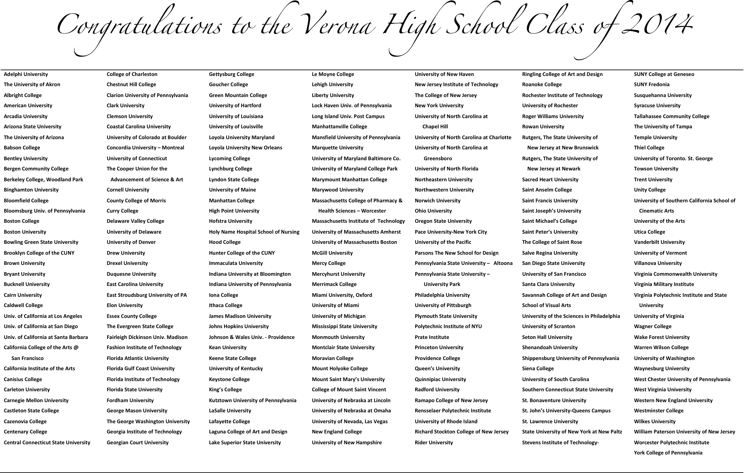
College Acceptances for 2013-14
Notes:
done

